Slide 1
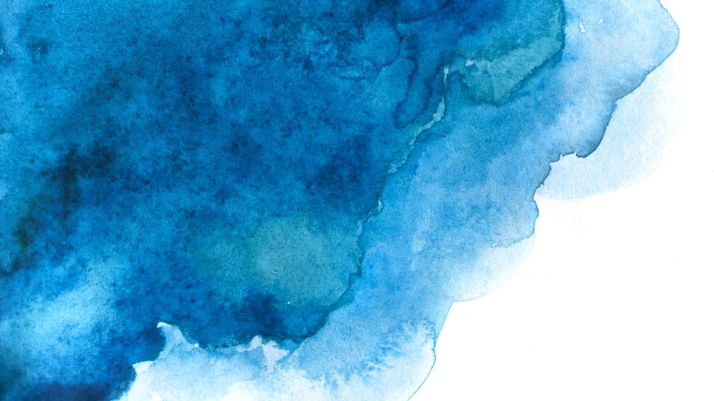
N.E.A.T.
Neuro-Evolution of Augmenting Topologies
Applied for a 2D Racing Game
By Munteanu Victor

Slide 2
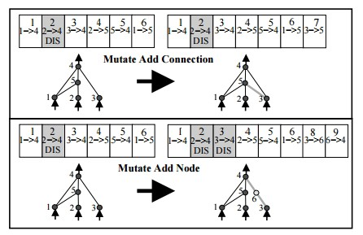
N.E.A.T.
Genetic Algorithm that evolves a graph-like structure
Besides the weights of the connections, it also mutates creating new connections between nodes and even new nodes.
Innovation numbers (used for cross-over)
Speciation (such that new structures will get more time to mature)

Slide 3
MarI/O

Slide 4
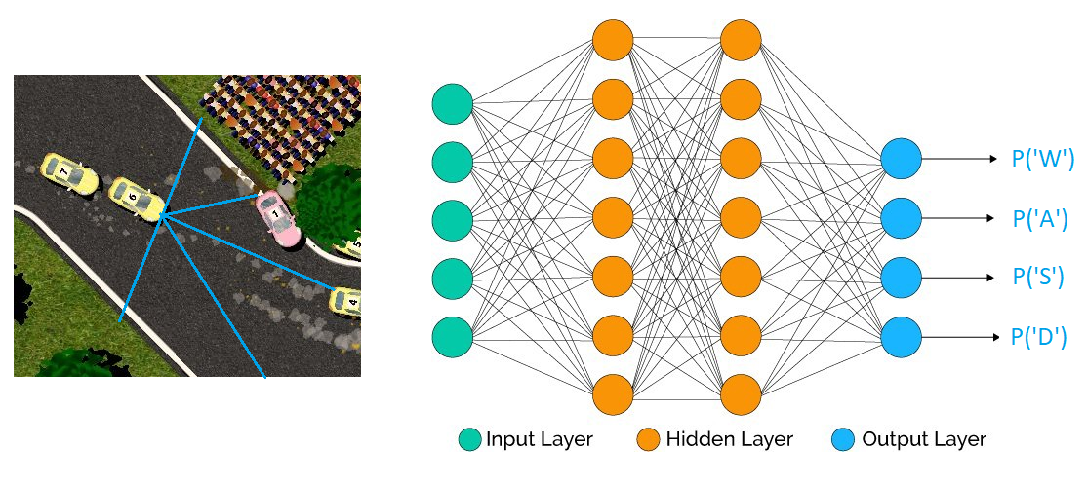
2D Racing Game
Input: the distance to the closest wall in each of the 5 directions
Output: Probability distribution over the actions

Slide 5
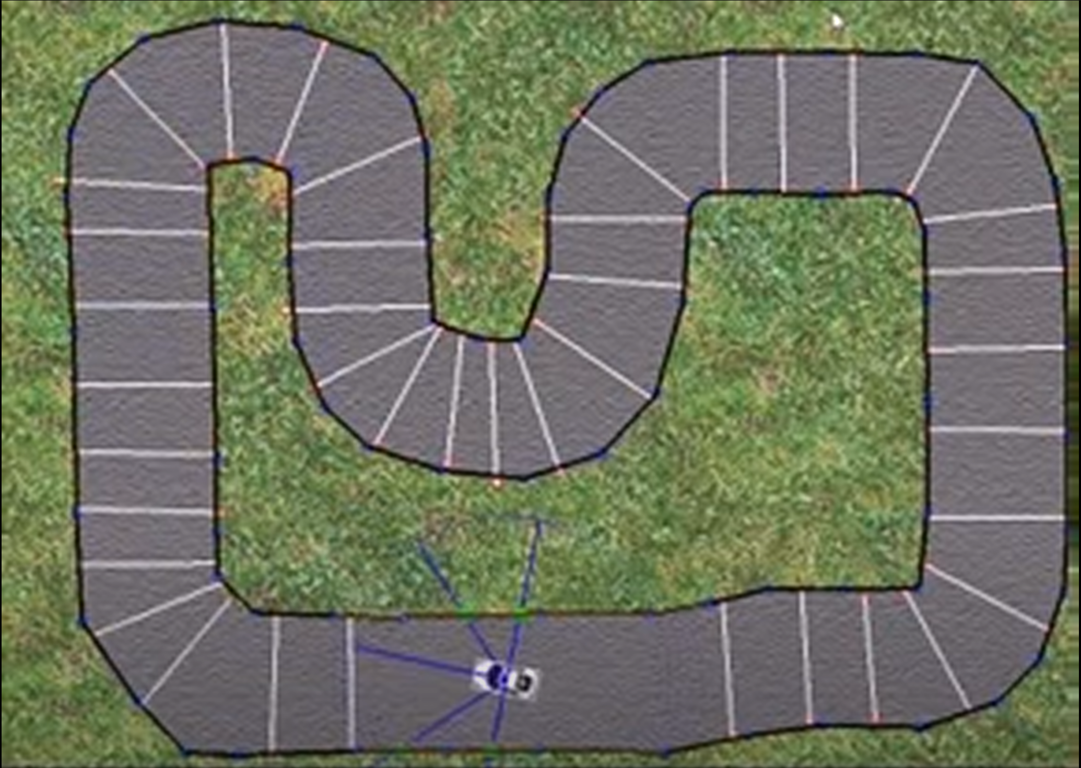
Metrics
Fitness function
Number of checkpoints it passed
Multiple types of tracks
Tighter roads
More sharp turns

